Slide 1
CAPSTONE PROJECT
Credit Card Approval Analysis
By Valluru Uday Kiran

Slide 2
Problem Statement
To create a comprehensive Data Pipeline with
Azure Data Factory and
Databricks
in order to create a Dashboard for Credit Card Approval Analysis and to derive useful business insights from it

Slide 3
Data Sources
The data sources used are:
Applicants Data –Blob
Applicants Data–HTTP (GitHub)
Credit Data– – SQL table – SQL DB

Slide 4
Solution Flow
Tech Stack
Azure Storage – For Data Ingestion & Storage
Azure Data Factory – For Pipeline
PySpark – For Transformations and Aggregation
SparkSQL – For Visualization
Azure Databricks – For Dashboard

Slide 5
Solution Flow
Pipeline
(using Cosmos DB)
(using PySpark)
Data Ingestion
Landing Zone
Data Cleaning
Transformations
(using Databricks)
(using SparkSQL)
(using PySpark)
Dashboard
Visualization
Materialized View
Aggregation

Slide 6
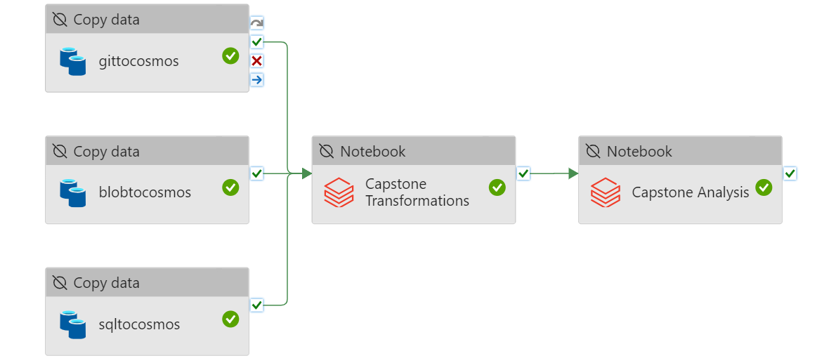
Solution Flow
Pipeline

Slide 7
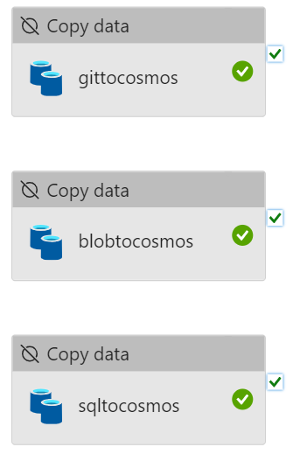
SOLUTION FLOW
Pipeline – Data Ingestion

Slide 8


Slide 9
Why NoSQL Cosmos DB for the Landing Zone ?
Global Distribution and Scalability
Low Latency with High Availability
Cosmos DB is schema-less, meaning you can have different fields in different records without any schema enforcement.

Slide 10
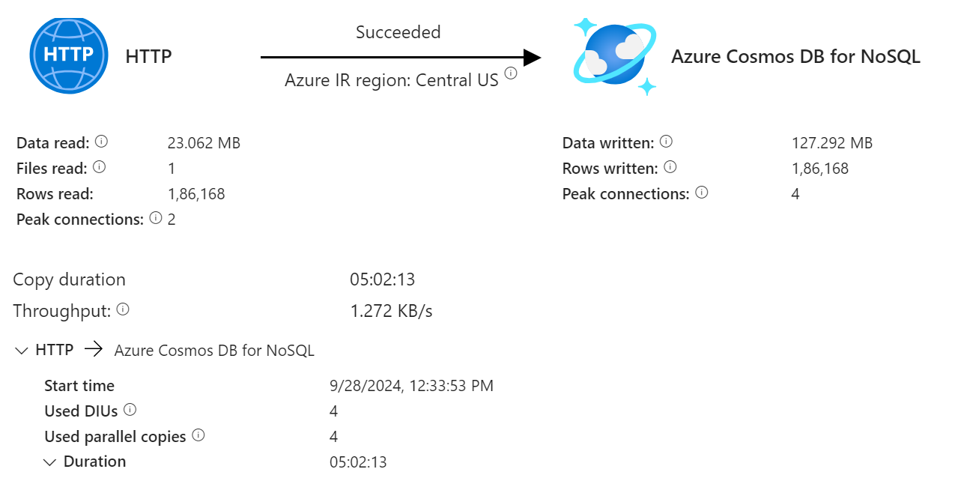

Slide 11
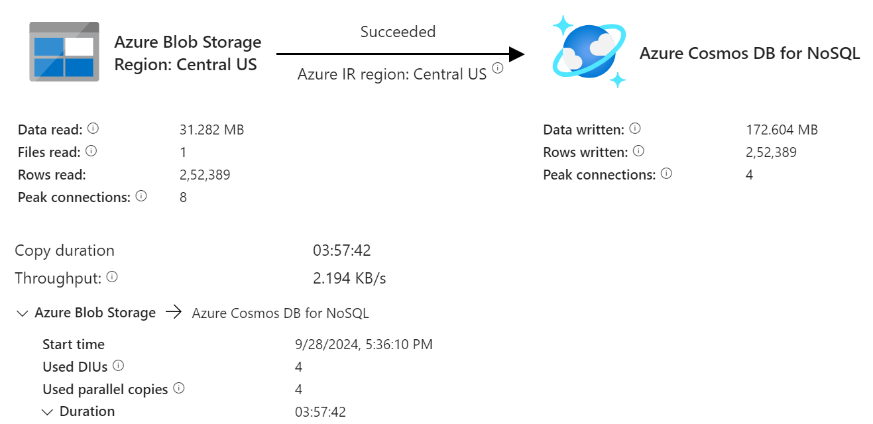

Slide 12
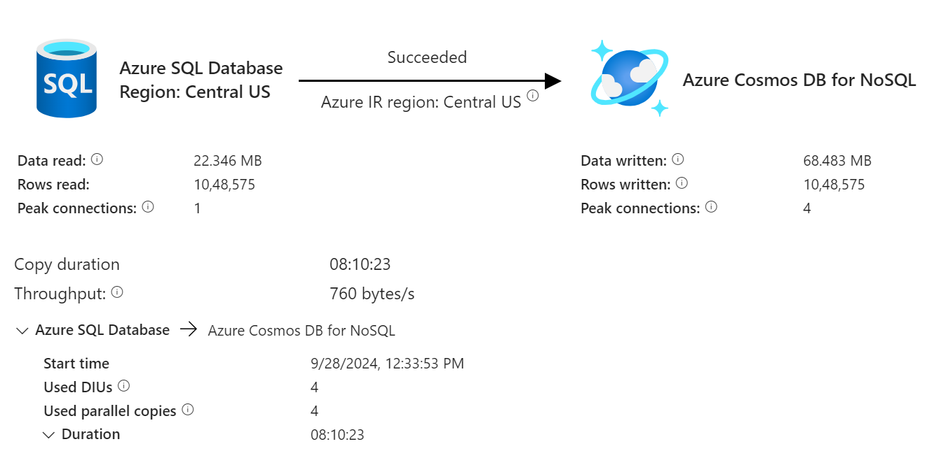

Slide 13
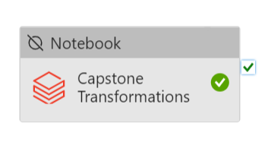
Solution Flow
Pipeline – Data Cleaning, Transformation & Aggregation

Slide 14
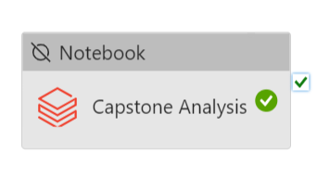
Solution Flow
Pipeline – Data Visualization

Slide 15
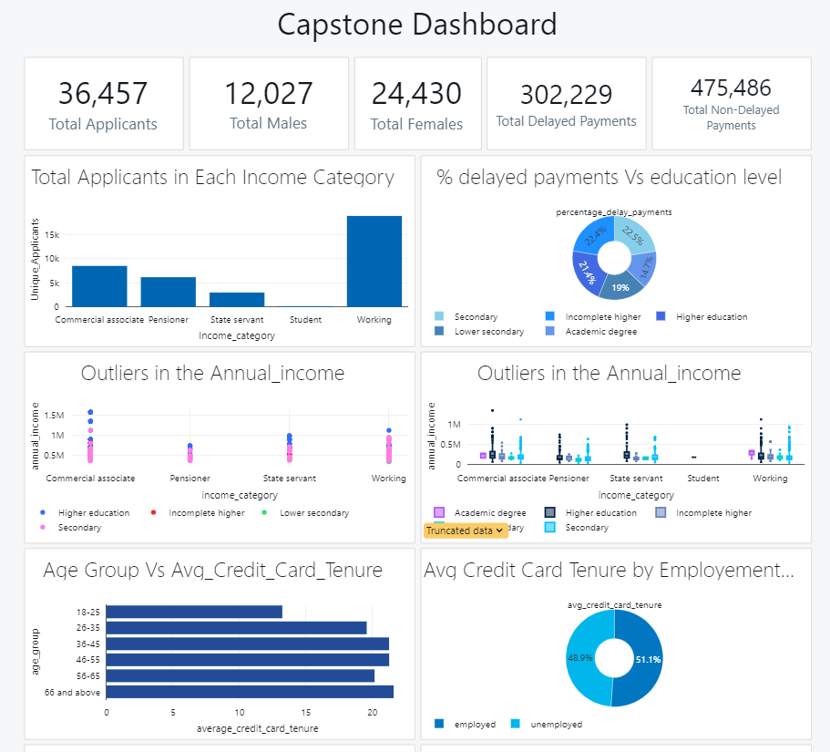
OUTPUT DASHBOARD

Slide 16
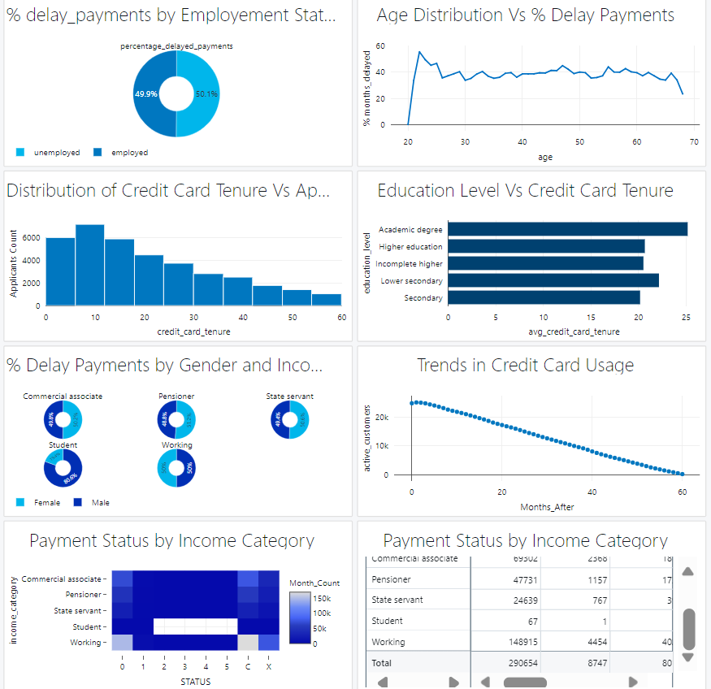
OUTPUT DASHBOARD

Slide 17
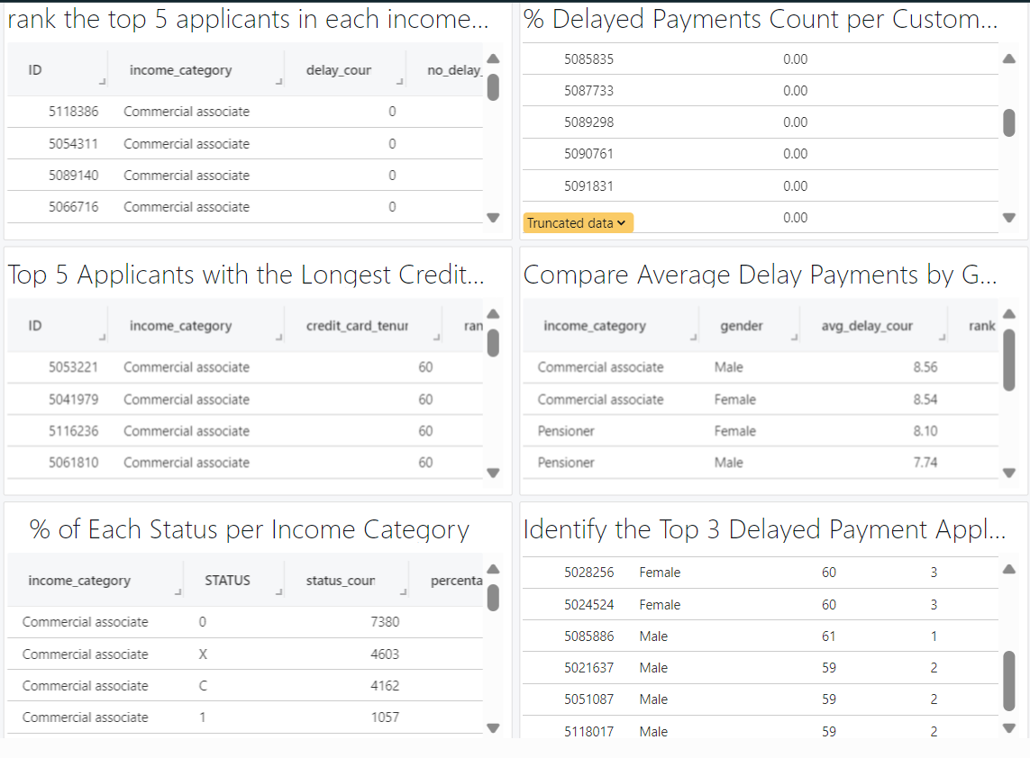
OUTPUT DASHBOARD

Slide 18
Results/Insights
From the data the following insights have been derived
By the analysis we can find that education level correlates with payment behavior. It appears that higher education levels like graduate school are having much more non-defaulter compared to lower education levels.
Customers with an academic degree have the longest average credit card tenure (25.1 months), suggesting that higher education correlates with long-term financial stability and responsible credit use.
Younger adults, especially those in their mid to late twenties, show a higher rate of defaulting. This could reflect early-career financial instability. In contrast, older customers (above 40) display more financial maturity, with lower default rates.
Both unemployed and employed individuals have similar delayed payment rates (~39%), indicating that credit management issues rises regardless of employment status. However, unemployed individuals tend to have shorter credit card tenures, reflecting financial instability.

Slide 19
Results/Insights
From the data the following insights have been derived
Trends in Credit Card Usage Seems to be Very bad as the number of active customers are gradually decreasing over the Months
Age and tenure shows that older age groups tend to have longer tenures. This could imply that older customers are more loyal and stable in debt payment.

Slide 20
Challenges Faced
1. Dataset Authenticity: Determining the genuineness of the dataset raised concerns about the validity of the analysis.
2. Performance Issues: The pipeline experienced longer running times, especially during data movement, leading to delays in data availability.
3. Budget Constraints: A strict budget limit of 100 USD for cloud services necessitated careful resource management to maintain essential operations.

Slide 21
Future scope
1)Upgrading the Architecture to support real-time Processing
2)Integrating more data sources such as user feedback ,social media trends and real time monitoring tools
3)Automation of the Dashboard in Azure
4)The Transformed data could be sent to following teams for further improvent…They are:
i)Data Analysts: Uses the pipeline's output for reporting and insights.
ii)Data Scientists: For Building models that can be deployed for predictive insights, such as credit scoring, fraud detection, or customer segmentation.
iii)CI/CD :For handling the pipeline's deployment and updates.
iv)DevOps :For Managing the infrastructure, scaling, and monitoring of the pipeline environment.

Slide 22
THANK YOU

